Slide 1
Lesson 12: Adjusting the GUI for a Better UX (User eXperience)
by Lambert, Scott

Slide 2
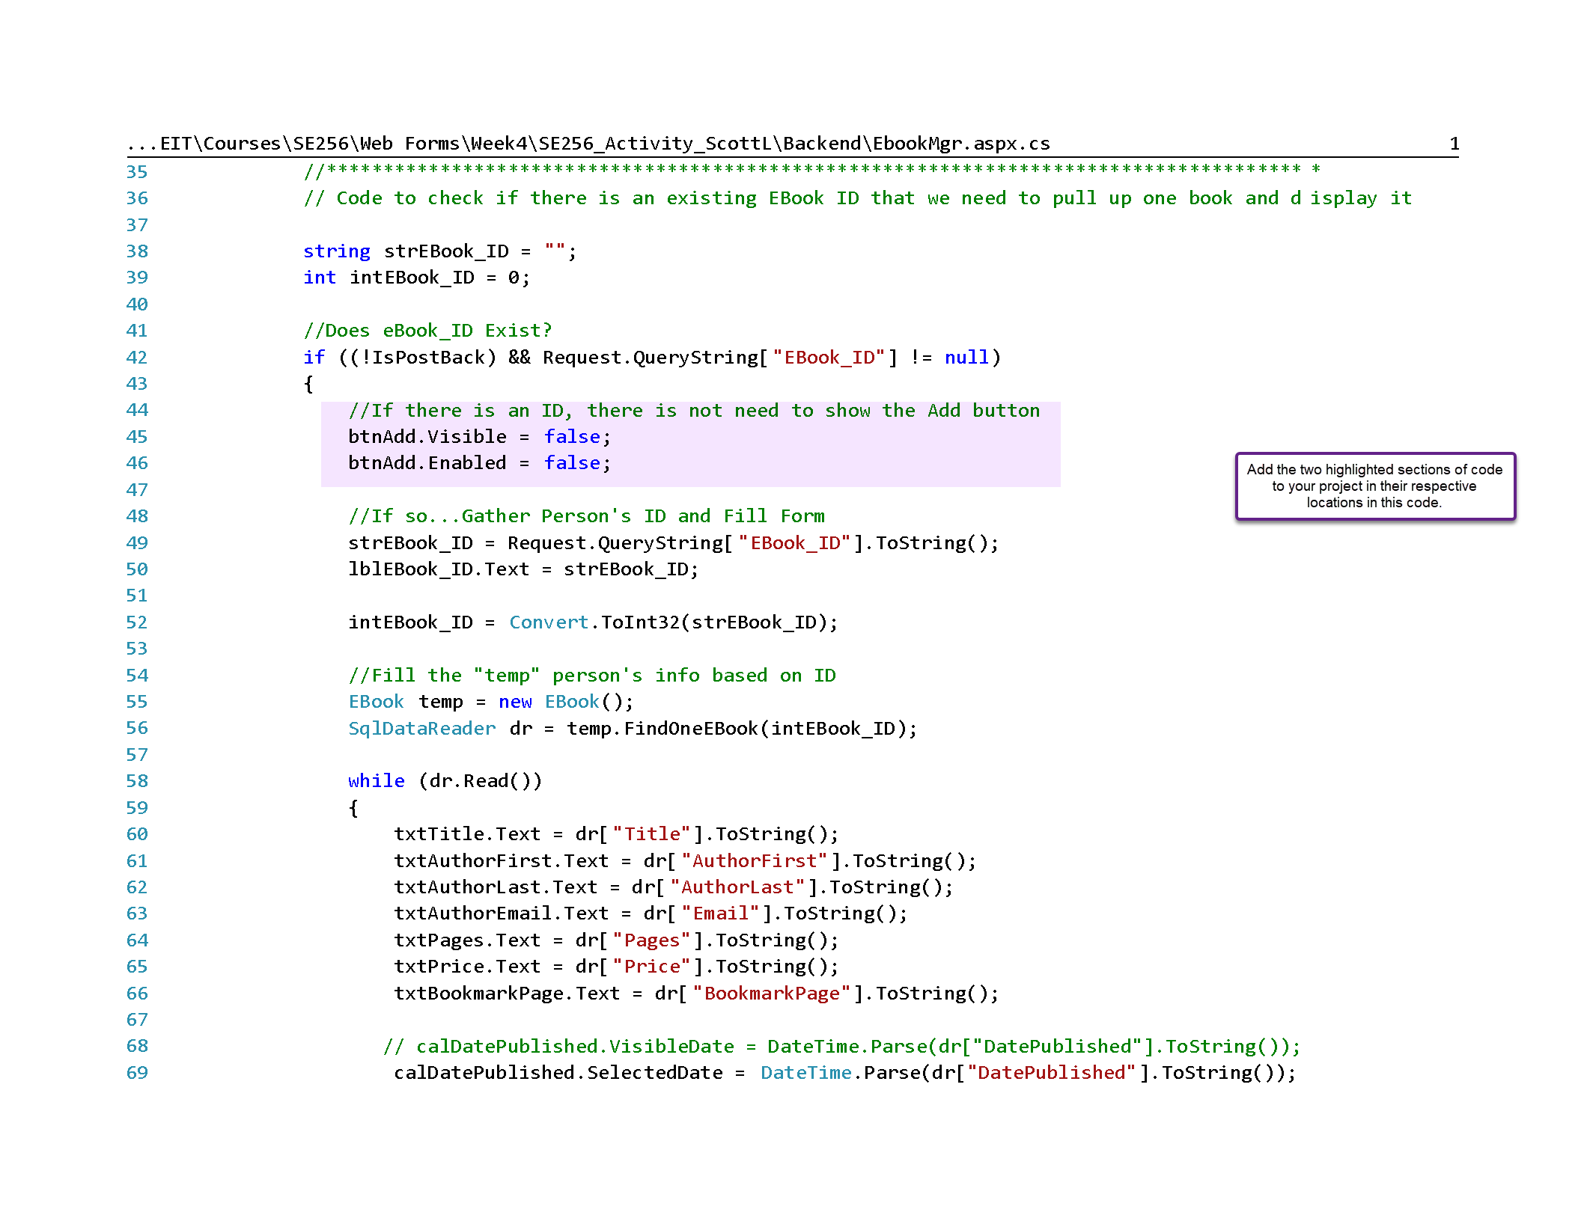

Slide 3
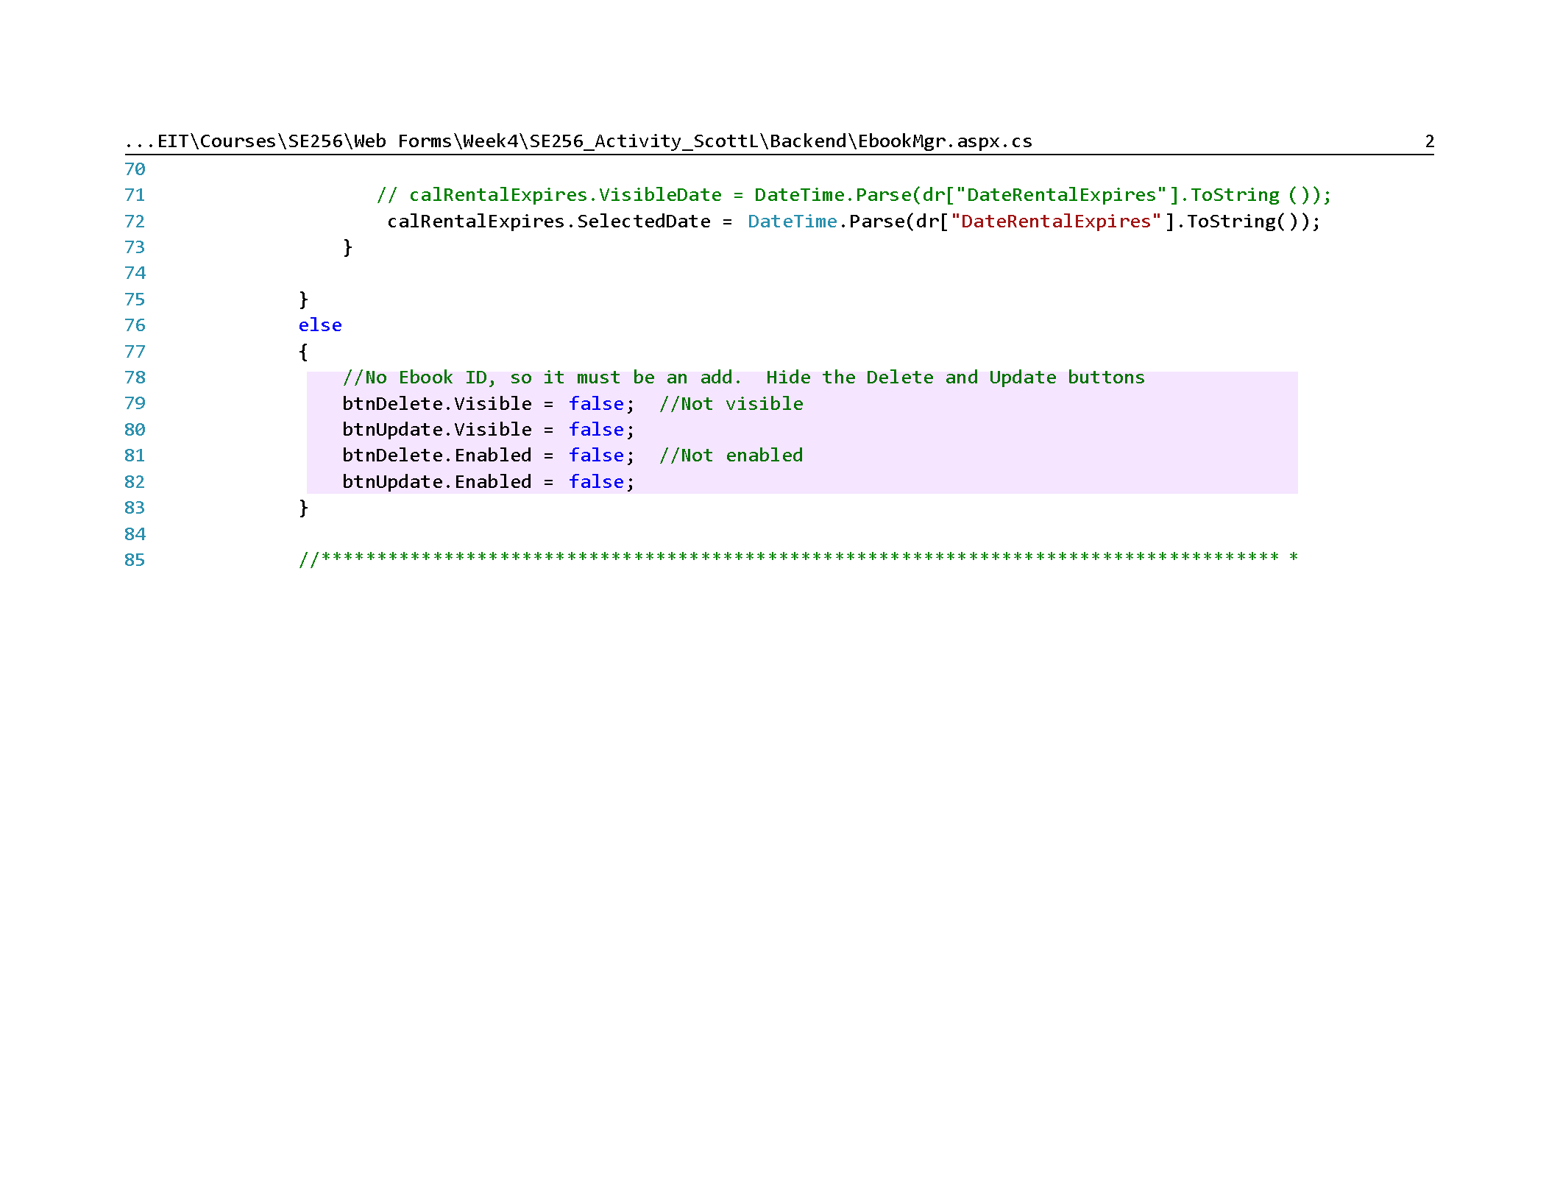

Slide 4
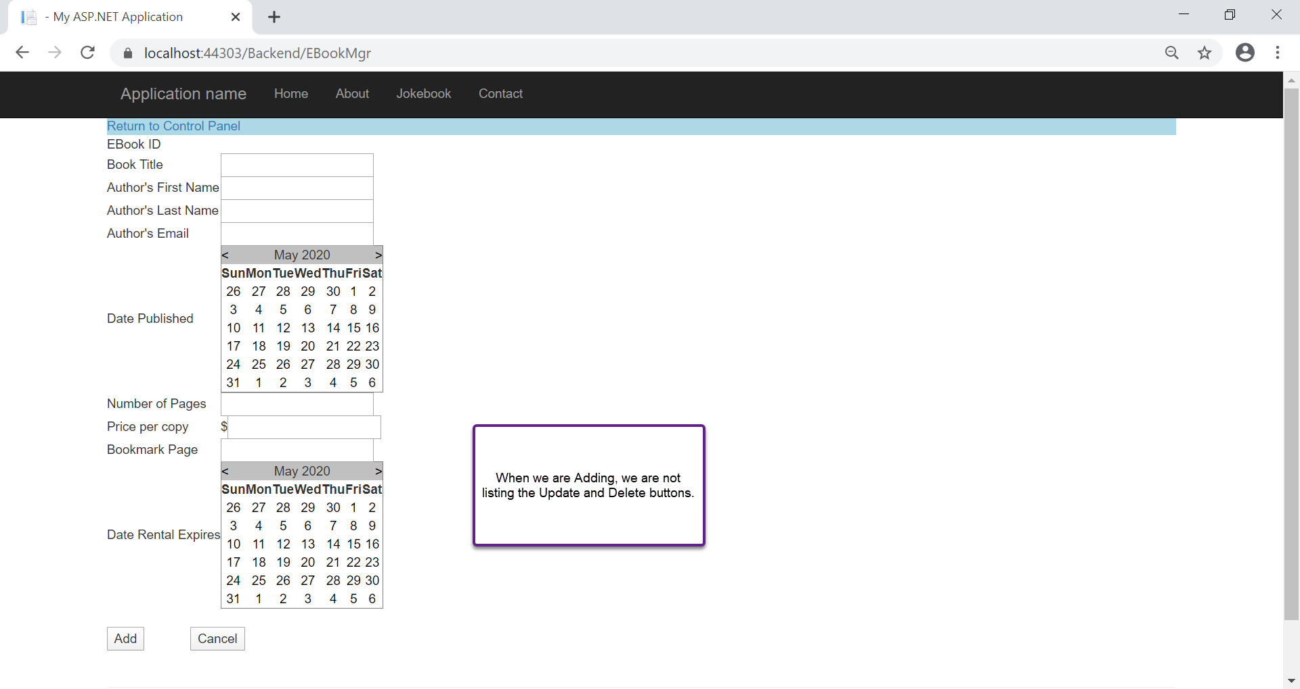

Slide 5
